Slide 1
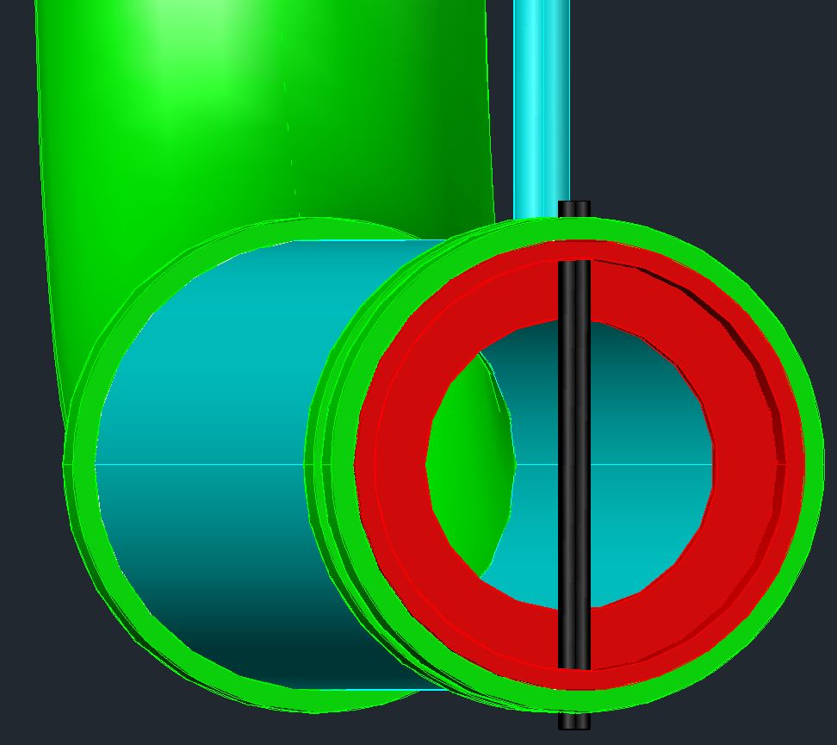
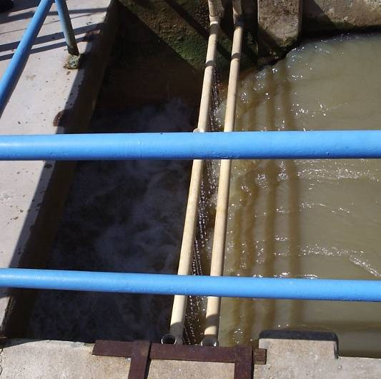
Coagulation and Rapid Mix: A search for a basis for rational design
Sustainable Municipal Drinking Water Treatment
continuing
failed
^
Aggregation
Intermolecular bonding
Mixing
Energy Dissipation
Shear and Diffusion

Slide 2
The quest to improve water treatment: What are our resources?
Experience operating water treatment plants
Conventional wisdom
Predictive performance models for drinking water treatment (Why is this hard?)
Rapid mix model
Flocculation
Sand filters
Opportunity! If we can figure out the physics we will be able to create better designs

Slide 3
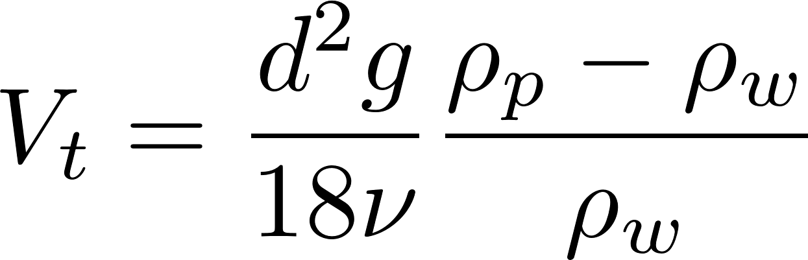
Gravity separation is awesome, but we need help
How could we increase the sedimentation rate of small particles?
Increase d (stick particles together)
Increase g (centrifuge)
Increase density difference
(dissolved air flotation)
Decrease viscosity (increase temperature)

Slide 4
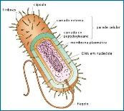
Seeking favorable interactions between particles
We add a sticky insoluble coagulant that forms nanoparticles
We design reactor geometry and flow regimes to create interactions between
Nanoparticles of coagulant precipitate
Dissolved organic molecules
Inorganic particles (like clay)
Organic particles (including pathogens)

Slide 5
Definitions
Coagulation: The process of adding a sticky solid phase material (adhesive nanoparticles) that attaches to the particles so they can attach to each other (the topic of these notes)
Flocculation: The process of producing collisions between particles to create flocs (aggregates) (next set of notes)

Slide 6
Aluminum Sulfate Chemistry Alum [Al₂(SO₄)₃*14.3H₂O]
A widely used coagulant
Typically 10 mg/L to 100 mg/L alum is used (0.9 to 9 mg/L as Al)
High concentrations (stock solutions) don’t precipitate because the pH is low
The alum precipitates when it blends with the water in the water treatment plant
The primary reaction produces Al(OH)₃
Al₂(SO₄)₃ + 6H₂O→2Al(OH)₃ + 6H⁺ + 3SO₄⁻²
pH = -log[H⁺]

Slide 7
Acid Neutralizing Capacity (ANC or Alkalinity) Requirement
Al₂(SO₄)₃ + 6H₂O→2Al(OH)₃ + 6H⁺ + 3SO₄⁻²
ANC is measured as mg/L of CaCO₃
How much ANC is consumed by alum?
 | Alum | Calcium Carbonate
Molecular Formula | Al₂(SO₄)₃*14H₂0 | CaCO₃
Molecular mass | 600 g/mol | 100 g/mol
eq/mol | 6 | 2
Molecular mass/eq | 100 g/eq | 50 g/eq
Simple guide | 1 mg/L Alum consumes | 0.5 mg/L Calcium Carbonate ANC
This sets the maximum alum dose that can be used for low alkalinity waters
Notes:
CUWFP has 140 mg/L calcium carbonate alkalinity. Therefore never have a problem with pH dropping too far with the addition of alum.
What do you do if the water ANC is too low? Add base OR switch to a less acidic coagulant.

Slide 8
Polyaluminum Chloride (PACl)
Slowly titrated with a base (in the chemical plant) to produce a meta-stable and soluble polymeric aluminum (partially neutralized)
Consumes less alkalinity (ANC), it is less acidic.
Aluminum mass fraction is higher than in alum (no 14.3 H₂O) so the mass of PACl required is less than for alum (0.4-10 mg/L as Al)
Notes:
What is the chemical formula of PACl?

Slide 9
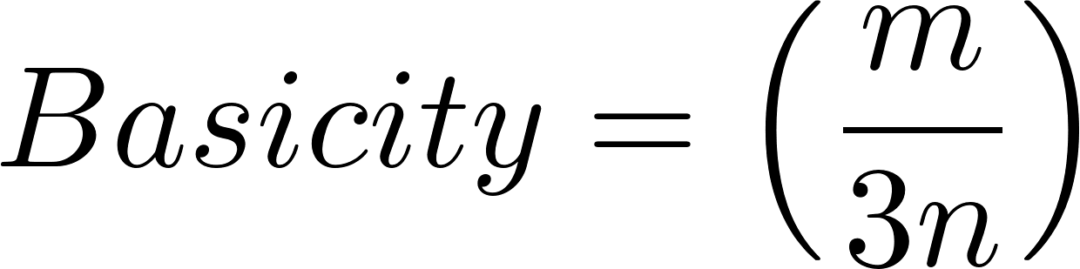
PACl Formula and Basicity [Al_{n}(OH)_{m}Cl_{3n−m}] _{x}
Basicity: Ratio of hydroxyl equivalents to aluminum equivalents
Basicity of 1 would mean that it does not produce any protons when it dissolves in water
0 means it produces 3 protons per Al (like alum)
The lowest basicity commercial PACls are about 10%
Most PACls are in the medium to high basicity range (50-70%)
Highest stable basicity (83%) is aluminum chlorhydrate (ACH) – would be useful for treating water with very low ANC
http://www.geosc.com/products/polyaluminum-chloride-(pac)
Notes:
http://wioa.org.au/conference_papers/2001/pdf/paper6.pdf

Slide 10
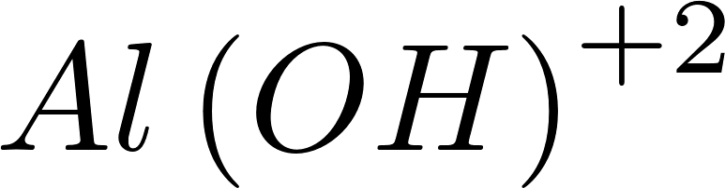
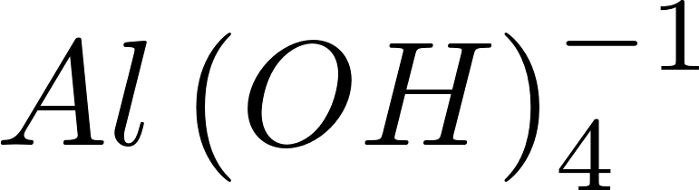
Aluminum Solubility
pH control is critical!
Coagulation fails at low pH and high pH because the coagulant becomes too soluble
Notes:
Solubility from Pernitsky, D. J. and J. K. Edzwald (2006). Selection of alum and polyaluminum coagulants: principles and applications. Journal of Water Supply: Research and Technology 55(2), 121-141

Slide 11
The Conventional Coagulation Hypothesis*
“The purpose of addition of coagulant chemicals is to neutralize the negative charges on the colloidal particles to prevent those particles from repelling each other.
Coagulants due to their positive charge attract negatively charged particles in the water.” http://www.thewatertreatments.com/wastewater-sewage-treatment/coagulation-flocculation-process/
* This hypothesis has been the explanation of coagulation for close to 100 years.
Notes:
Notice the focus on eliminating repulsion. We now suspect that the coagulant precipitate is attracted to particle surfaces.

Slide 12
Surface charge of Particles and Natural Organic Matter (NOM)
NOM significantly increases the required coagulant dose in some waters
The coagulant required increases with NOM concentration
Charge density (conventional explanation)
Clay: 0.05 to 0.5 μeq/mg (1 mg/L clay ≈ 1 NTU)
Fulvic acid 5 to 15 μeq/mg C
NOM also has a larger surface area* per unit mass than clay particles and thus provides many attachment sites for coagulant nanoparticles
Notes:
Selection of alum and polyaluminum coagulants: principles and applications
David J. Pernitsky and James K. Edzwald Journal of Water Supply: Research and Technology—AQUA | 55.2 | 2006
* Surface area could be at the molecular scale or could be thought of as sites where nanoparticles could attach.

Slide 13
Electrostatic Charge Neutralization
Explains phenomena such as the aggregation of sediment suspensions in estuaries
Explains many particle stability experiments with pure systems of nanoparticles
May not explain the particle interactions that occur in flocculation using aluminum and iron based coagulants

Slide 14
Coagulation: The adhesive nanoparticle hypothesis
Aluminum coagulants (alum and polyaluminum chloride) produce adhesive nanoparticles of precipitated aluminum hydroxide that attach to particles including to other nanoparticles
The attractive attachment force must be stronger than the polar bond between water molecules so the nanoparticles can push water out of the way
Predictive performance model for hydraulic flocculator design with polyaluminum chloride and aluminum sulfate coagulants Karen A. Swetland, Monroe L. Weber-Shirk*, Leonard W. Lion

Slide 15
Sticky nanoparticles?
Effective flocculation only occurs when the coagulant is in the solid phase
Thus NaOH and Ca(OH) ₂ are not effective coagulants because they are soluble at neutral pH
Al(OH)₃ likes to stick to itself and to other surfaces
Why is the solid phase Al(OH)₃ and Al₁₃O₄(OH)₂₄ ⁷⁺ sticky? (Perhaps because it is more polar than water)

Slide 16
On Rapid Mixing…
“In summary, little is known about rapid mix, much less any sensitivity to scale. However, the models and data reviewed suggest the need to be on the lookout for certain effects. From what is presently known, it can be speculated that since coagulant precipitation is sensitive to both micro- and macro-mixing, scale-up must consider not only energy dissipation rate, but also the reaction injection point and the contacting method.”
Mixing in Coagulation and Flocculation 1991 page 292
Notes:
Mixing in Coagulation and Flocculation 1991 page 292

Slide 17

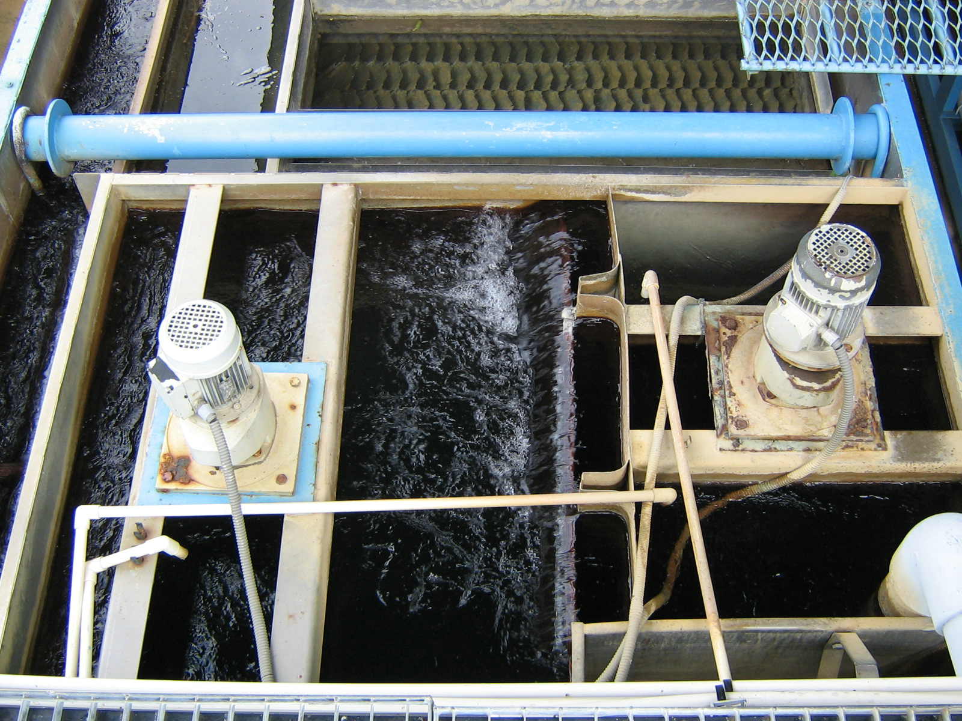


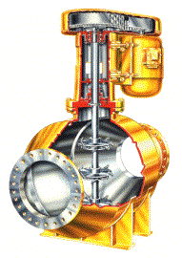
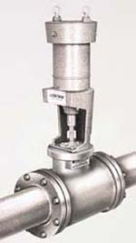
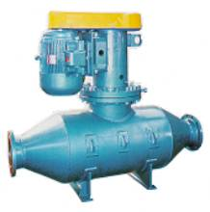
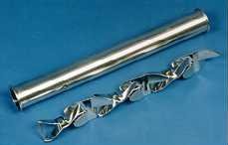
Traditional rapid mix units
Backmix mechanical reactors
In-line blenders
Hydraulic Jump
In-line static mixers

Slide 18
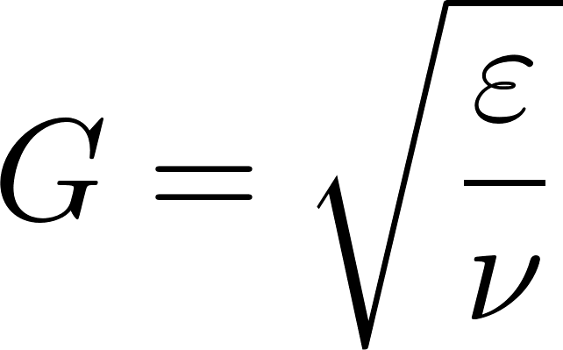
Traditional Design
Conventional design is based on the use of G (velocity gradient) as a design parameter.
We don’t know what the design objective is for rapid mix and thus it isn’t clear what parameter matters
“…a high degree of turbulence leads to more efficient chemical use for destabilization by adsorption and charge neutralization, whereas destabilization by precipitation is less sensitive to the mixing conditions.” (Water Quality Engineering – Benjamin and Lawler, 2013)
In drinking water treatment the coagulant dosages are almost always higher than the solubility limit; perhaps rapid mix isn’t important

Slide 19
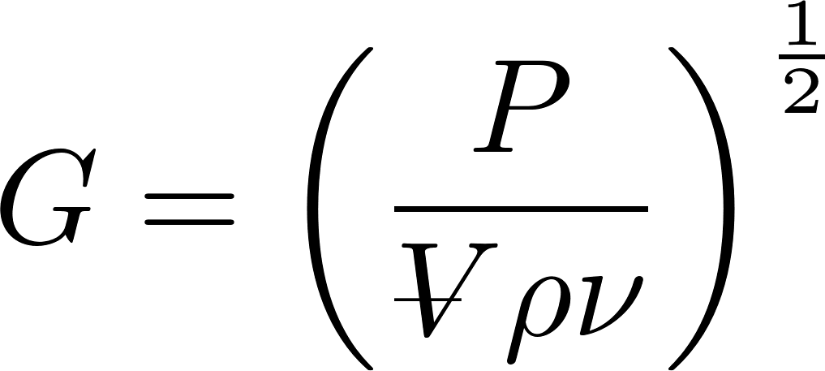
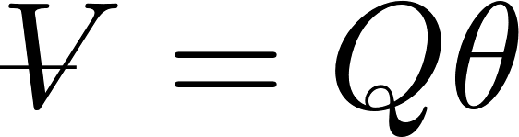
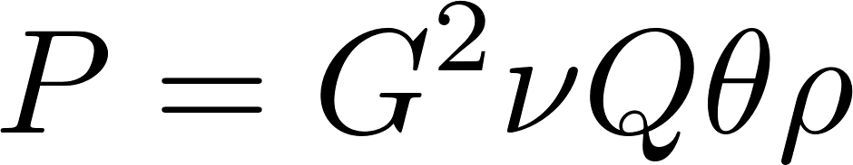
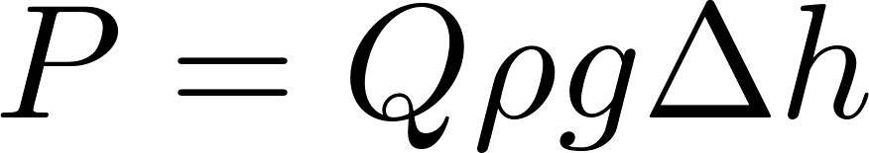
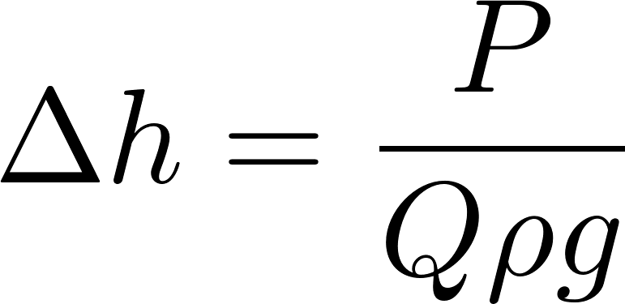
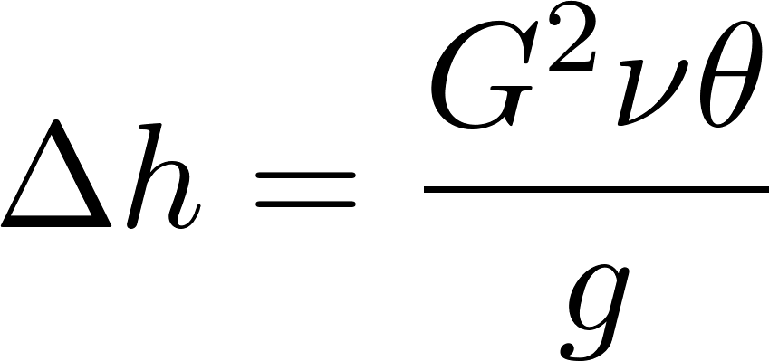
Power, height, and G
This is the traditional approach
“velocity gradient” caused by mixing
Reactor volume
Power required
Power required to lift water
Equivalent potential energy measured as a height used for mixing
Equivalent potential energy as a function of G
Notes:
from Environmental Engineering: A Design Approach by Sincero and Sincero. 1996. page 267

Slide 20
Traditional Design Guidelines: Mixing with a Propeller
Average values
Residence Time (s) | “velocity gradient” (G) (1/s) | Energy dissipation rate (W/kg) | Equivalent height (m)*
0.5 | 4000 | 16 | 0.8
10 – 20 | 1500 | 2.25 | 2.3 – 4.6
20 – 30 | 950 | 0.9 | 1.8 – 2.8
30 – 40 | 850 | 0.72 | 2.2 – 2.9
40 – 130 | 750 | 0.56 | 2.3 – 7.5
No mention of scale effects
from Environmental Engineering: A Design Approach by Sincero and Sincero. 1996. page 267
* A measure of mechanical energy converted to heat
Notes:
from Environmental Engineering: A Design Approach by Sincero and Sincero. 1996. page 267
Conversion to energy dissipation rate assumes viscosity of 1 mm^2/s

Slide 21
Hydraulic Energy Constraint
If we use the same amount of mechanical energy in hydraulic water treatment plants as is used in mechanical water treatment plants we will need between 0.8 and 7.5 m of water height change just to power the rapid mix unit!!!!!
Rapid mix is one of the largest energy consumers in mechanical plants
We need to be more efficient (and hence smarter)

Slide 22

Why might RAPID mixing be necessary?
Mix the adhesive nanoparticles uniformly with the raw water (definitely important if the flow is split between treatment trains)
IF RAPID mixing matters then there must be something bad that happens if the mix is SLOW (but maybe it doesn’t matter)
Self aggregation of nanoparticles into microclusters
Non-uniform distribution of nanoparticles between particles
Not clear if this matters or how to control it
Notes:
I’m guessing that the se
Self aggregation of nanoparticles will begin when diffusion blends enough raw water with the coagulant to raise the pH so that the nanoparticles become sticky – this diffusion may occur in a few seconds
If the nanoparticles are only dispersed in a fraction of the raw water then some raw water particles won’t receive any nanoparticles
We will find that we need an energy dissipation rate of >1 W/kg to distribute nanoparticles between particles
cond constraint is the dominant one. This requires more work!

Slide 23
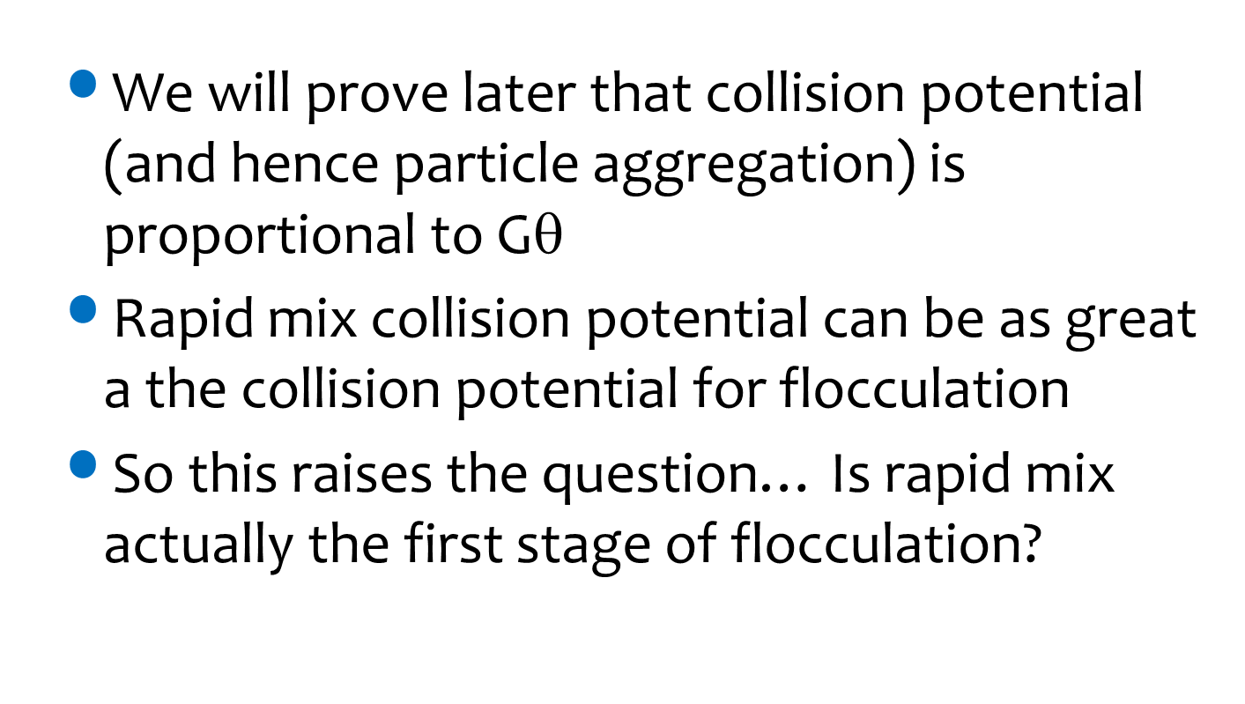
Or maybe rapid mix is actually the first stage of flocculation!
We will prove later that collision potential (and hence particle aggregation) is proportional to G$\text{q}$
Rapid mix collision potential can be as great a the collision potential for flocculation
So this raises the question… Is rapid mix actually the first stage of flocculation?

Slide 24
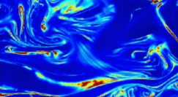

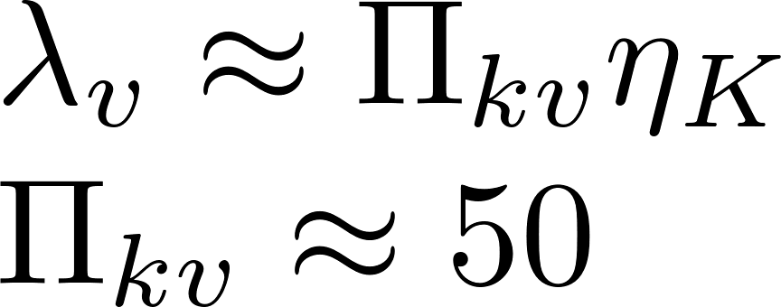

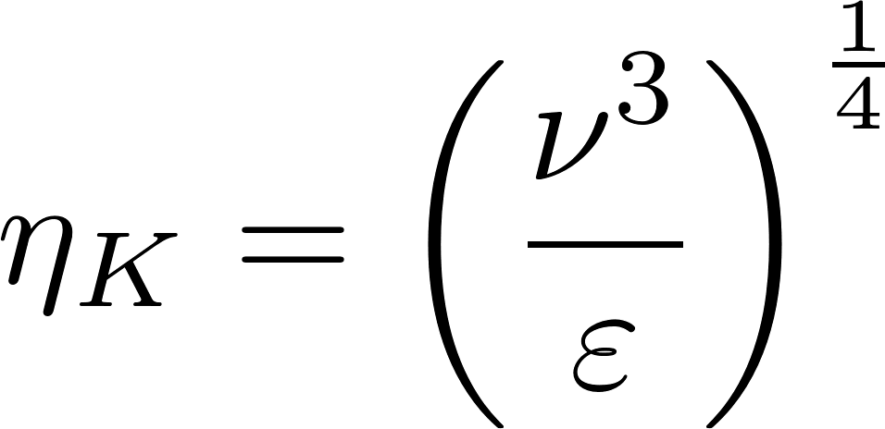


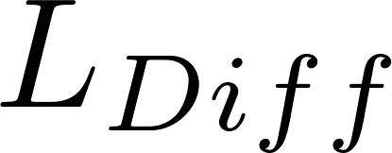

Rapid Mix: From macro to nano scale (in a few seconds?)
Length scale
Transport Process
Result
m
Rapid Mix flow dimension
Large eddies
Small eddies
mm
Inner Viscous scale
μm
Viscous shear
nm
Molecular diffusion
Molecular scale

Slide 25
Three steps for mixing
Large scale eddies to mix at the dimension of the reactor (Macro mixing)
Generate large eddies
Flow expansion with dimensions similar to the dimension of the reactor, pipe, or channel
Critical if the flow splits between treatment trains
Turbulence to mix down to the scale of the smallest eddies (Micro mixing)
Fluid shear and diffusion to transport the coagulant nanoparticles to the particles and pathogens
Goals aren’t clear

Slide 26
Possible constraints
Fluid must be fully turbulent to get efficient mixing by eddies
Re>10,000 (this seems like a good goal)
Uniform distribution of coagulant between particles (all particles get some glue)
Constraint isn’t obvious
Shear/Diffusion of nanoparticles from fluid phase to particle surfaces occurs in a reasonable amount of time (ideally completed before flocculation)
Might not be possible

Slide 27
Turbulence – Mixing – Energy Dissipation
The turbulent eddies cause stretching and thinning of concentration gradients and “shuffle” packets of fluid
The intensity of the turbulence can be characterized by the rate at which mechanical energy is being lost to thermal energy

Slide 28
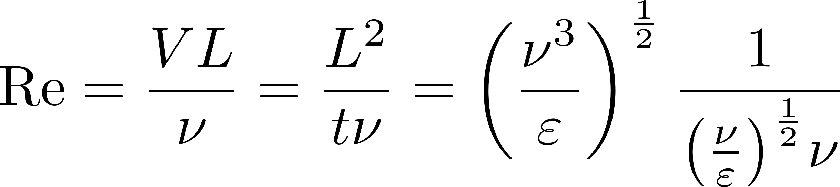
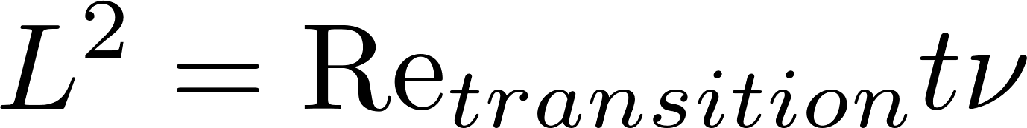
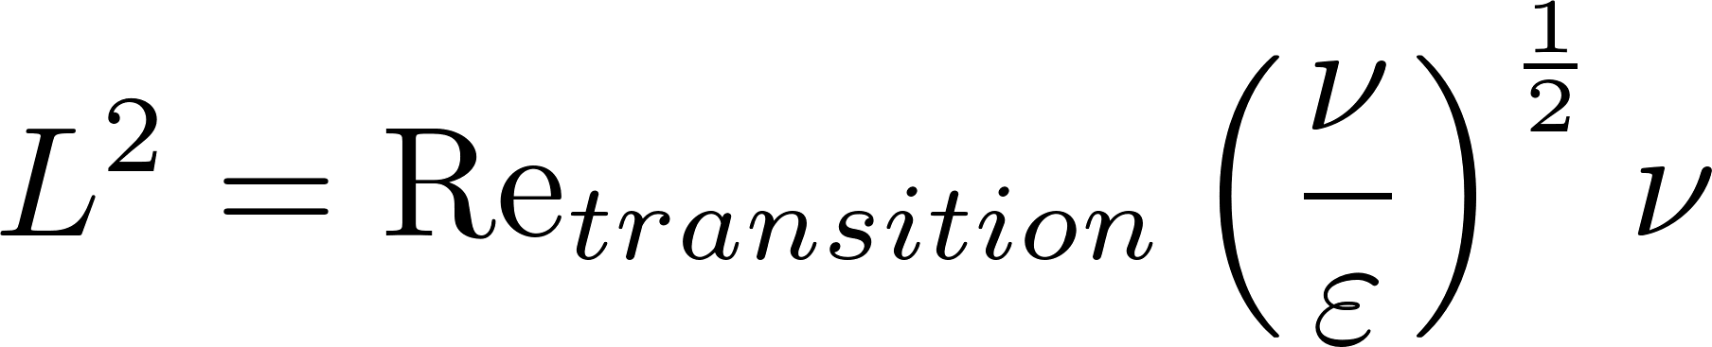
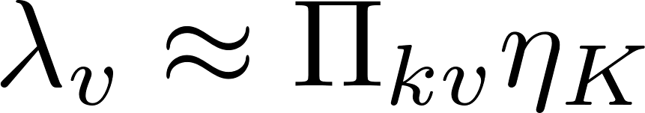
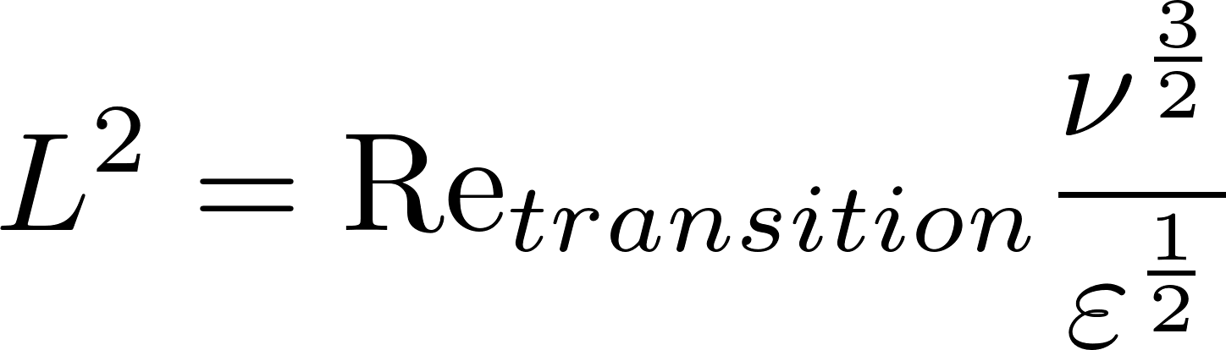
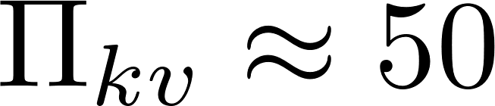
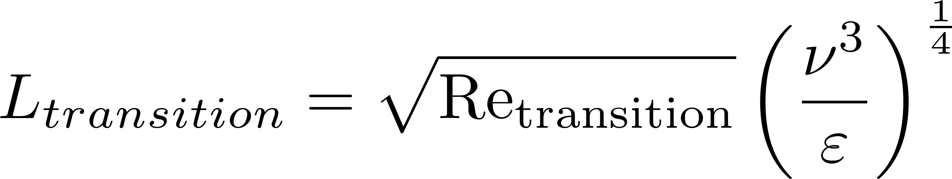
How Far Can Turbulence Mix? (Viscous inner scale)
Dissipates energy from the mean flow through chaotic eddies and through viscosity where the kinetic energy is converted to heat
Turbulence is a great mixer down to about 50x* the Kolmogorov scale
Kolmogorov length scale
Inner viscous length scale
Eddies cause mixing
Shear and diffusion
*http://dimotakis.caltech.edu/pdf/Dimotakis_JFM2000.pdf
Viscosity kills inertia (and eddies)!
ν, viscosity, for water is 10⁻⁶ m²/s
Notes:
http://dimotakis.caltech.edu/pdf/Dimotakis_JFM2000.pdf
What is fluid shear?

Slide 29
Mixing below the inner viscous length scale is by shear and diffusion
The viscous shear and molecular diffusion processes are both slow
There is no practical way to speed diffusion
A contact chamber might be helpful*
Time for dissolved organics to diffuse to coagulant nanoparticles
Time for nanoparticles to diffuse to particles and pathogens
* Edge of knowledge

Slide 30
AguaClara design…
We have speculated that energy dissipation rate mattered
We had an flawed justification for about 3 W/kg
We don’t currently have a rational basis for design of a rapid mix unit
The 1 L/s pilot plant offers us the opportunity to do the needed research.

Slide 31
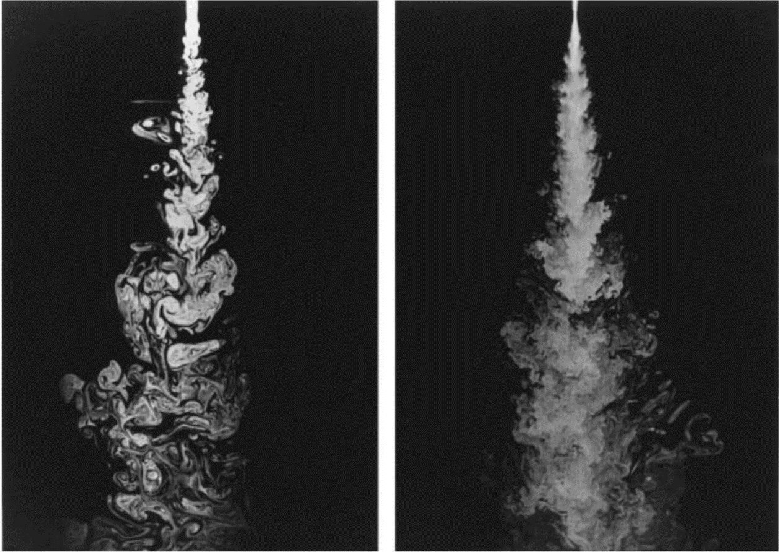
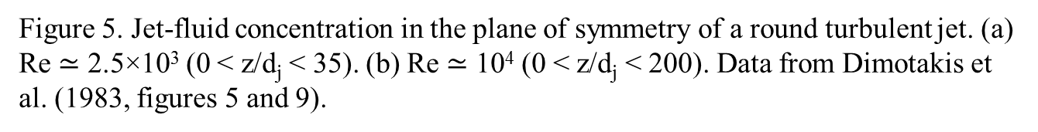
The minimum Reynolds number for efficient mixing is 10,000
Figure 5. Jet-fluid concentration in the plane of symmetry of a round turbulent jet. (a) Re $≃$ 2.5×10³ (0 < z/d_{j} < 35). (b) Re $≃$ 10⁴ (0 < z/d_{j} < 200). Data from Dimotakis et al. (1983, figures 5 and 9).
Notes:
http://dimotakis.caltech.edu/pdf/Dimotakis_JFM2000.pdf

Slide 32
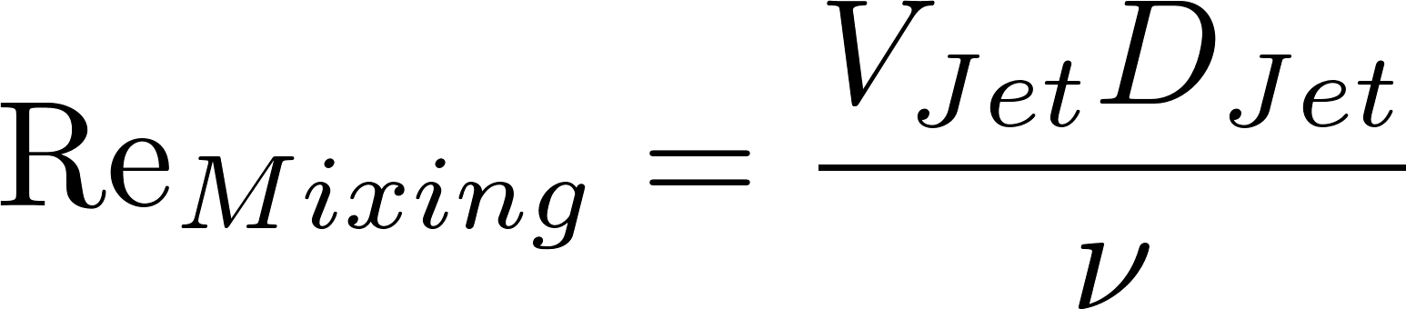
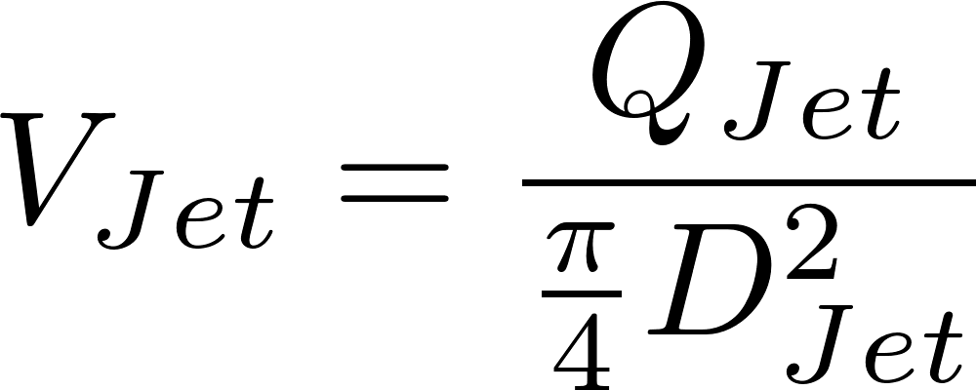
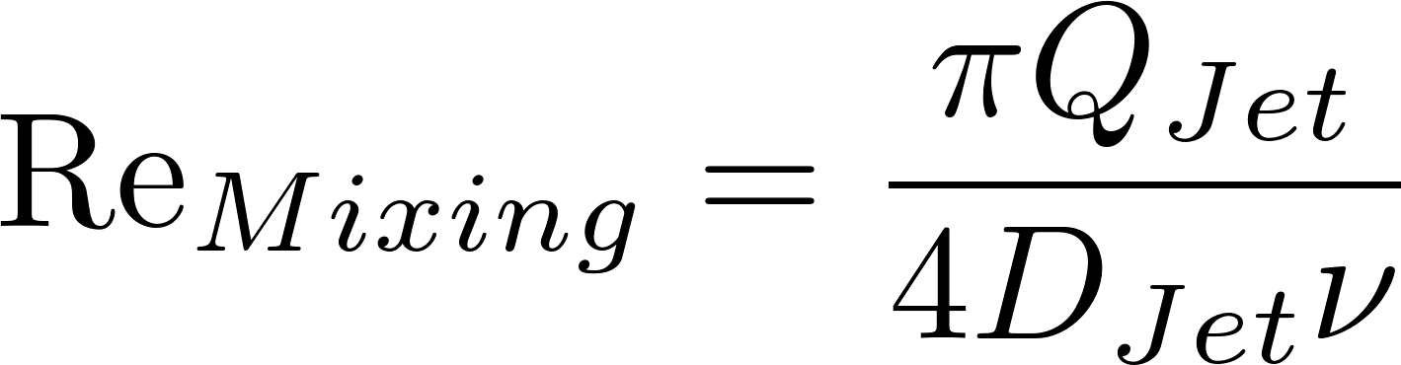
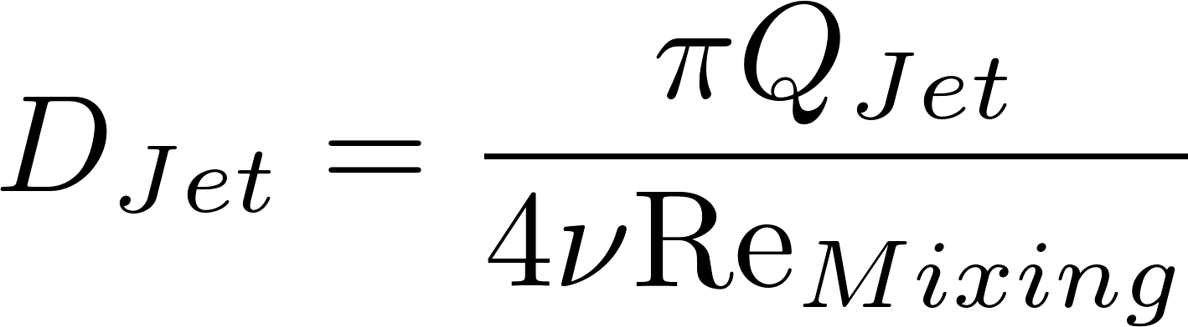
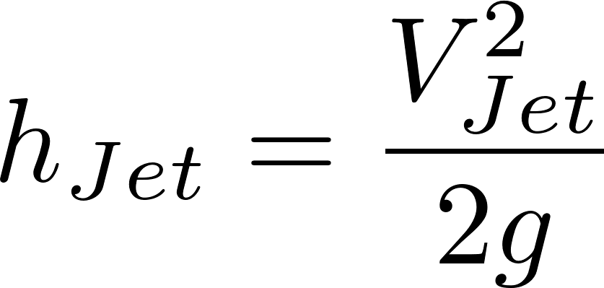
The Reynolds Number requirement may be a challenge for lab scale flows and irrelevant above 0.1 L/s
Definition of Re
Continuity
Replace V with Q
Solve for jet diameter
Head loss for a flow expansion
Notes:
Rapid Mix Exploration

Slide 33
Disclaimer
The following analysis is based on the assumption (without basis) that there may be a goal of achieving a certain energy dissipation rate or velocity gradient.
Aggregation of large particles may happen faster than deposition of nanoparticles on particles (flocculation may start well before coagulation ends).
A quiescent contact chamber may be more effective because nanoparticles benefit more (than clay particles) from diffusion.

Slide 34
How do we generate intense turbulence?
We need to be converting mechanical energy (kinetic energy) to thermal energy
We want “concentrated” head loss! (this shouldn’t be too hard to achieve!)
Therefore use minor loss (related to a change in flow geometry) rather than major loss (from shear at the solid boundaries)
Almost all minor losses are caused by expansions (We need a flow EXPANSION)

Slide 35
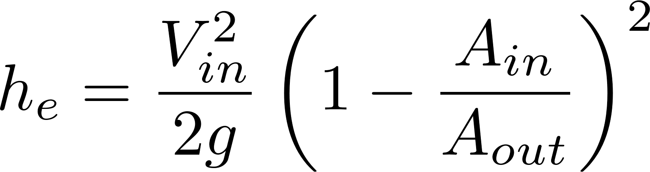
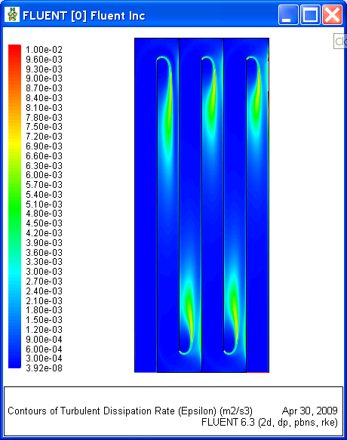
Flow Expansion
The control volume analysis gave us the total energy loss, but it doesn’t give us the energy dissipation rate.
The energy dissipation rate varies with location in the expanding jet

Slide 36
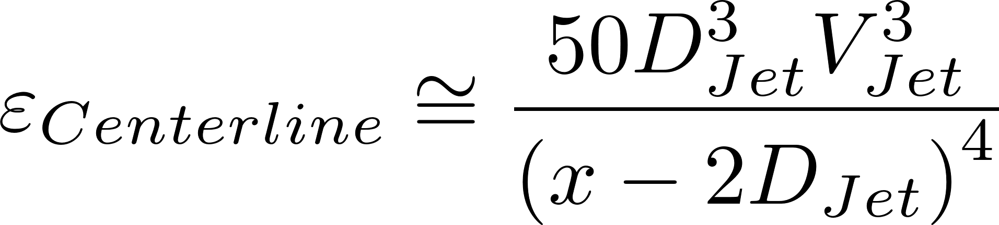
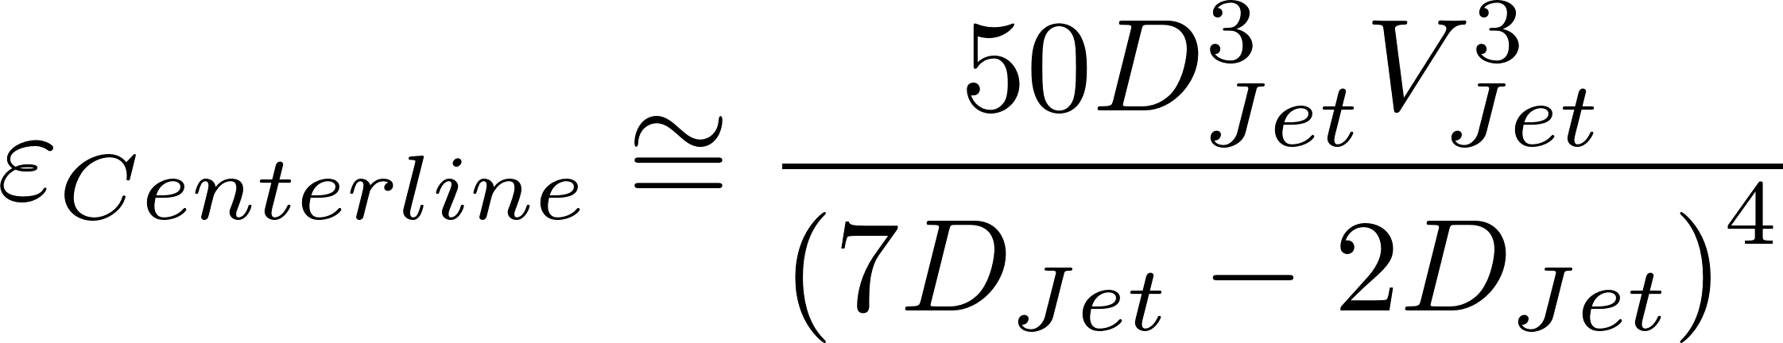
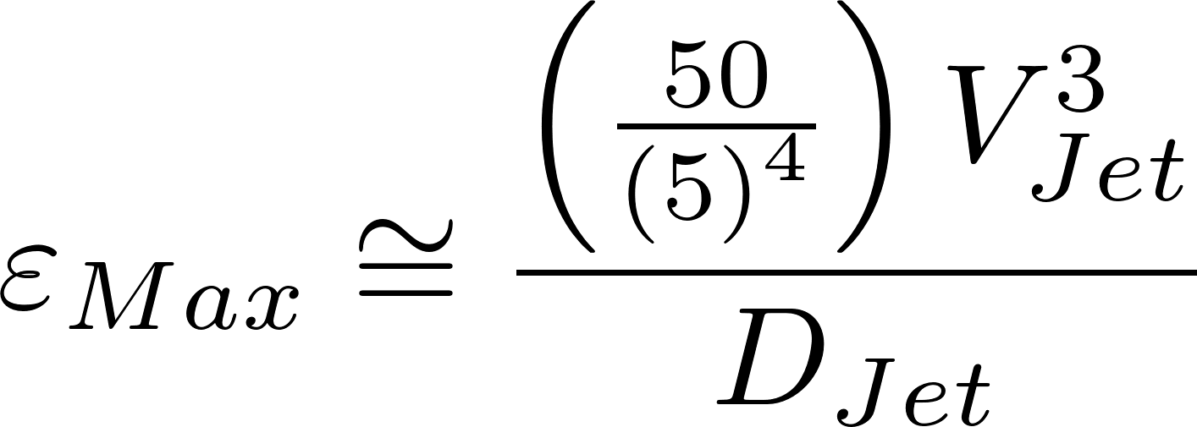
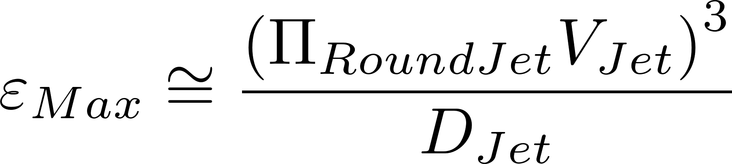
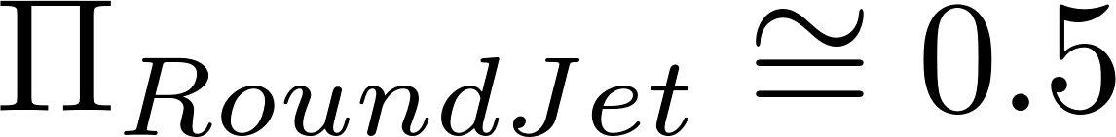
Jet Mixing
Minimum x for which this relationship is valid is
x is distance from the jet origin
The value we will use in our analysis. Further work is require to determine the best value of this parameter for different jet geometries.
Notes:
Chemical Engineering Science, Vol. 50, No. 12, pp. 1877-1880, 1995
THE INFLUENCE OF VISCOSITY ON MIXING IN JET REACTORS
Jo BALDYGA, J. R. BOURNE* and R. V. GHOLAP
Technisch-Chemisches Laboratorium, ETH-Zentrum, CH-8092 Zurich, Switzerland

Slide 37
Energy Dissipation Rate Three orifices, same velocity
Which jet has the highest energy dissipation rate?
A
B
C
Which jet has the highest shear (or velocity gradient)?
Notes:
Smallest orifice dissipates the energy in less time (and distance). Thus energy dissipation rate is HIGHEST in the smallest orifice.

Slide 38
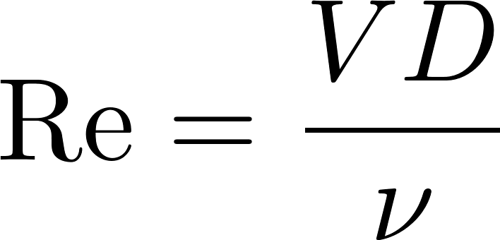
Big eddies create smaller eddies
Which jet has the largest eddies?
Which jet will make the smallest eddies first?
Which jet will dissipate energy the fastest?
Higher energy dissipation rates give a smaller Kolmogorov scale!
Notes:
Big jet has biggest eddies
Small jet makes Kolmogorov length scale eddies first
Small jet dissipates energy fastest.

Slide 39
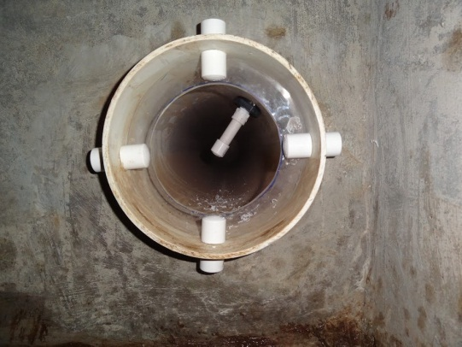
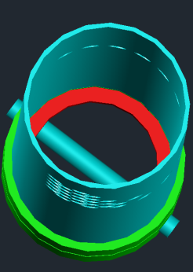
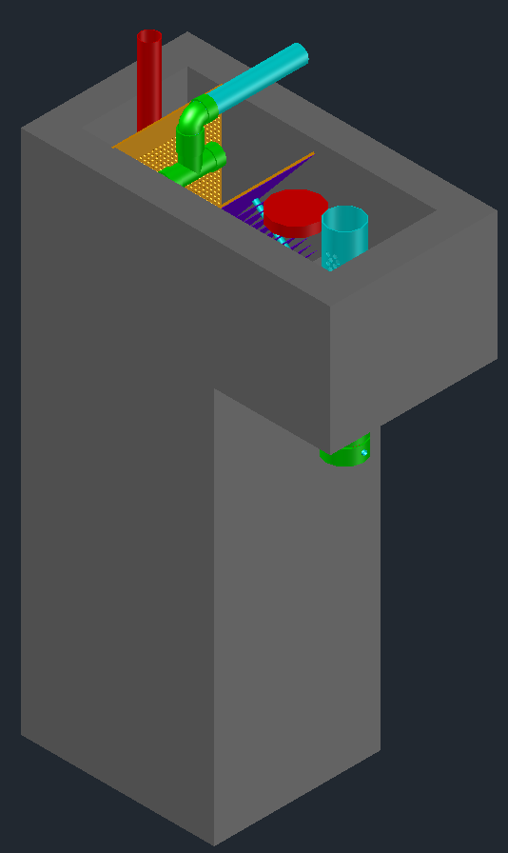
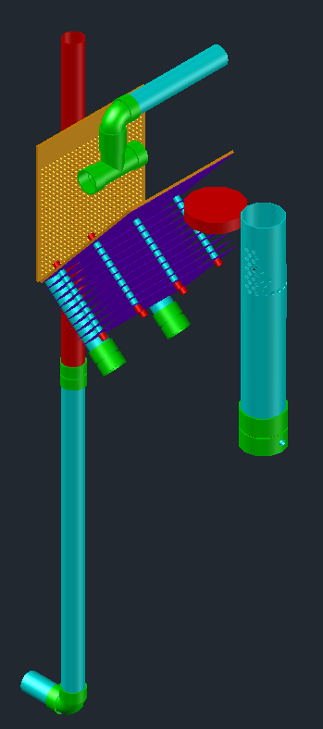

Rapid Mix orifice
Drain plug
CDC Float
Pin to keep plate in place
Inlet
LFOM
Rapid mix orifice

Slide 40






Orifice Diameter to Obtain Target Mixing (Energy Dissipation Rate, Kolmogorov Length Scale)
extra
Substitute for D_{Jet} and solve for D_{Orifice}
The orifice must be smaller than this to achieve the target energy dissipation rate

Slide 41





Rapid Mix Head Loss
extra
This is one of the scale effects for rapid mix
Why?
This assumes discharge into a large tank
Notes:
DC Hydraulic Rapid Mix 14 solution.xmcd
All of the kinetic energy in the jet is lost. Minor loss coefficient is 1

Slide 42
Reduce the required head loss through the rapid mix for large plant flows
extra
Rapid Mix head loss increases with Q
How could we maintain a high energy dissipation rate while reducing the velocity and the head loss?
What else is needed?
Use a plate with multiple orifices in the rapid mix pipe and add macro mixing upstream

Slide 43
Hypothesis: Macomixing minor loss coefficient and length scale
extra
The eddy velocities are comparable to the mean velocities for a minor loss coefficient of 1
The minimum distance in the direction of flow (L) for mixing over the dimension perpendicular to the direction of flow (D) would then be equal to D. (L>D)
This length is the pipe minimum length before the micromixing event (unless the two are combined in a single orifice)

Slide 44
Mechanized Rapid Mix vs. Hydraulic Rapid Mix
Vampire loads
A 100 L/s AguaClara plant costs approximately $1,000,000
After 25 years the electricity cost for mechanized rapid mix would be $230,000
“Another way to give is to not take…”
The 25 year energy cost for a package plant that uses a total of 400 J/L is 1.5 million USD!
Or perhaps just turn off the mixer?

Slide 45
Reflections
Hydraulic rapid mix should be the default design
Research is required with our pilot plant to determine if rapid mix makes a difference or if a quiescent contact chamber would be more beneficial
Rapid mix might be the first stage in flocculation

Slide 46
Turbulent Micromixing followed by molecular diffusion
extra
Large scale eddies move packets of fluid around at the scale of the flow (or the scale of the separation distance of the injection points
…Smaller eddies move packets of fluid over smaller length scales…
Smallest scale eddies create high concentration gradients at Kolmogorov scale (viscosity kills turbulence at this scale)
Molecular diffusion finishes the job

Slide 47
Velocity gradients increase interfacial area
extra
Turbulence causes chaotic movement of the fluid with spatially and temporally varying velocity gradients (not like this image!)
Net effect is to increase the interfacial area between the fluids being mixed by stretching and deforming the fluids
What will I find if I take 1 μm³ samples and measure the concentration after short exposure to turbulent mixing?

Slide 48

Turbulent Mixing
extra
10 cm
Cowen - "An Experimental Investigation of Scale-Dependent Plume Physics"
Notes:
Cowen - "An Experimental Investigation of Scale-Dependent Plume Physics"

Slide 49



How Fast can Diffusion Mix?
extra
What are the units of diffusion?
Diffusion is the product of a velocity and a path length – [L²/T]
How long will it take for diffusion to blur the concentration gradient left by turbulent mixing?

Slide 50





Molecular Diffusion Quantified
extra
Einstein relation (by Albert Einstein in 1905)
Boltzmann’s constant
Avogadro’s constant
Boltzmann’s constant
Density of the particle
Temperature (K)
Avogadro’s constant
Fluid dynamic viscosity
Molecular weight
For Al(OH)₃ the molecular diffusion coefficient is 10⁻⁹ m²/s
Notes:
MW is molecular weight
Subscript P is for particle
Subscript M is for molecular
It is actually the water molecules that are diffusing around the coagulant nanoparticles!

Slide 51






Turbulent Mixing so that Molecular Diffusion can finish the job
extra
Turbulence will mix to the inner viscous length scale
Perhaps should be to the outer viscous scale
Diffusion will mix this far in this time
Set the length scales equal
If we use a 1 W/kg micromix event then diffusion will take 2500 s
This assumes that diffusion rather than shear is the dominant transport mechanism. Need to model collision time between clay particle and nanoparticle based on shear transport to determine whether shear or diffusion dominate.
Notes:
Do we need to calculate time for diffusion to deliver nanoparticles to the particles? I don’t know how to do that calculation…
We could calculate a velocity based on this time and the length scale and then use the flocculation collision model to estimate time to collide.

Slide 52


Kolmogorov Length scale may be smaller than what can be achieved by eddies
extra
outer scale δ
Liepmann–Taylor
Kolmogorov dissipation scale, λ_{K}
an inner viscous scale, λ_{ν}
λ_{ν} is the scale where viscous effects become negligible
Notes:
At the other end of the spectrum, the inertial-range requirement that internal eddying motions must be inviscid dictates that their local scale λ must be large with respect to an inner viscous scale, λν , which we may assume as proportional to the (defined) Kolmogorov dissipation scale, λK (14). This allows the inequality that bounds the inertial range of scales (15) to be refined, i.e
http://dimotakis.caltech.edu/pdf/Dimotakis_JFM2000.pdf

Slide 53


Viscous energy dissipation
extra
Viscous effects extend up to about 50x the Kolmogorov length scale.
Energy is dissipated well before the eddies reach the Kolmogorov length scale
Notes:
http://dimotakis.caltech.edu/pdf/Dimotakis_JFM2000.pdf

Slide 54







Average distance between particles is the cube root of the volume occupied (Λ)
extra
The average volume of water “occupied” by a particle!
Need to know number of particles per volume (n_{P})
The number of flocs decreases as the flocs grow in size

Slide 55




Hypothesis: Energy Dissipation Rate for Micromixing
extra
If the inner viscous length scale is large compared with the distance between particles, then distribution of nanoparticles between particles may be non-uniform
Set energy dissipation rate to make inner viscous length scale less than separation distance between particles

Slide 56
nanoparticle attachment time
extra
The following is a very preliminary estimate of the time required for attachment of the nanoparticles to the clay particles
This analysis includes multiple simplifying assumptions and there is a reasonable possibility that some of those assumptions are wrong

Slide 57



How much water is cleared of nanoparticles by a clay particle?
extra
Volume cleared is proportional to a collision area defined by a ring around the clay particle with width of the diameter of the nanoparticle diffusion band
Volume cleared is proportional to time
Volume cleared is proportional to the relative velocity between clay and nanoparticles
Notes:
The exact width of this collision ring is likely significantly less

Slide 58
Diffusion length scale
Fluid velocity
Clay
Coagulant nanoparticle

Slide 59





Use dimensional analysis to get a relative velocity
extra
Viscous dominated collisions with
Or should this be based on lambda?
Assume linear
Confirmation of the G notation for particle collisions
dimensions
Notes:
The length scale is the average separation distance of the flocs

Slide 60



Diffusion band thickness
extra
Time that nanoparticle is in vicinity of clay particle

Slide 61






Collision Rates
extra
viscous
t_{c} is average time per collision for each clay particle present
Relative velocity
Time for one collision
This analysis is missing a correction factor that accounts for how many nanoparticles within the collision ring that are actually able to make contact and the actual flux of fluid through that ring in a shear environment
$N_{c}$ is number of successful collisions per clay.
Notes:
Find the time to clear the volume occupied by one floc.
Then we need to find the average relative velocity of the two flocs based on their average separation distance.

Slide 62



Collision Rate and Particle Removal
extra
Geometry
Track nanoparticle concentration as rapid mix progresses with nanoparticle number concentration, n_{NC}, as our master variable
Removal of nanoparticles through collisions with clay particles
Tracking residual nanoparticles!

Slide 63





Integrate
extra
Clay size is assumed constant because the addition of nanoparticles has a small effect on size.
Mass concentration is proportional to number concentration

Slide 64
Estimated time for 50% of nanoparticles to attach to clay
extra
These times assume that flocculation isn’t happening! Given that particles are aggregating at the same time the space between particles is growing and thus application of the nanoparticles takes longer than predicted here.
Notes:
Rapid mix exploration 2.xmcd

Slide 65

Stages of particle removal
extra
Interactions between particles, reactor geometry, and fluids
Coagulation
Flocculation
Floc Blanket
Sedimentation
Filtration
nanoparticle deposition
Collisions
More Collisions
Gravity!
Last chance!
Notes:
Here are the five stages of particle removal in hydraulic drinking water treatment plants. The first stage, coagulation, involves the addition of a chemical coagulant to destabilize a suspension of particles. The coagulant precipitates and attaches to the particle surface. Then in flocculation, velocity gradients in the water cause the particles (now coated in precipitated coagulant) to collide and stick to one another forming aggregates. In floc blankets there are many more opportunities for collisions. In sedimentation, fluid flow is very slow and the aggregates settle to the bottom of the tank. Filtration is often used to remove any remaining particles but is not included in the bench-scale setup.

Slide 66

extra
Sante Mattson J. Phys. Chem., 1928, 32 (10), pp 1532–1552, DOI: 10.1021/j150292a011
Publication Date: January 1927

Slide 67



Effects of pH and Coagulant Dosage: pH = 6
Zeta potential went to zero (charge neutralization occurred) before best turbidity removal
Best performance occurred when zeta potential reached a positive value that exceeded the initial negative value
Clay partially covered with PACl
pH = 6
http://dx.doi.org/10.1016/j.cjche.2015.02.003
Fig. 1. Effect of PACl dosage (as Al) on residual turbidity (○) and zeta potential (■) for kaolin suspensions at final pH values of 6.0 (a), 7.0 (b), 8.0 (c) [34] and 10.0 (d). Initial kaolin concentration: 100 mg·L− 1; water temperature: (15 ± 1) °C; rapid mixing: 245 s⁻ ¹, 3 min; slow mixing: 15 s⁻ ¹, 10 min; settling: 10 min. Initial turbidity was 68 NTU.
Notes:
This graph shows the behavior of improving performance, deteriorating performance, improving performance that has been described as charge neutralization, charge reversal, sweep floc. The problem is that best performance doesn’t correspond with charge neutralization. Thus there must be more to this than charge neutralization.
The deteriorating performance may not be of practical significance because there is no reason to operate a plant at such high PACl dosages. But it would be helpful to understand the physics/chemistry that causes worsening performance at high dosages. One possible explanation is that surface coverage beyond 50% is not helpful because the strongest bonds are between PACl precipitate and a negatively charged site on the clay. But then does performance improve again above 80 mg/L as Al. As this high Al dose there is far more PACl precipitate than clay (by volume). Perhaps the flocs containing clay settle out and the flocs that are pure PACl precipitate remain in suspension and
Where do water treatment plants operate?
Ning Wei, Zhongguo Zhang, Dan Liu, Yue Wu, Jun Wang, Qunhui Wang
Coagulation behavior of polyaluminum chloride: Effects of pH and coagulant dosage ☆
Chinese Journal of Chemical Engineering, Volume 23, Issue 6, 2015, 1041–1046
http://dx.doi.org/10.1016/j.cjche.2015.02.003

Slide 68

Effects of pH and Coagulant Dosage: pH = 8
extra
Zeta potential went to zero (charge neutralization occurred) at best turbidity removal
This data fits the charge neutralization hypothesis except that performance at +15 mV zeta potential is not the same as performance at -15 mV.
pH = 8
http://dx.doi.org/10.1016/j.cjche.2015.02.003
Fig. 1. Effect of PACl dosage (as Al) on residual turbidity (■) and zeta potential (○) for kaolin suspensions at final pH values of 6.0 (a), 7.0 (b), 8.0 (c) [34] and 10.0 (d). Initial kaolin concentration: 100 mg·L− 1; water temperature: (15 ± 1) °C; rapid mixing: 245 s⁻ ¹, 3 min; slow mixing: 15 s⁻ ¹, 10 min; settling: 10 min. Initial turbidity was 68 NTU.
Notes:
Ning Wei, Zhongguo Zhang, Dan Liu, Yue Wu, Jun Wang, Qunhui Wang
Coagulation behavior of polyaluminum chloride: Effects of pH and coagulant dosage ☆
Chinese Journal of Chemical Engineering, Volume 23, Issue 6, 2015, 1041–1046
http://dx.doi.org/10.1016/j.cjche.2015.02.003

Slide 69
Effects of pH and Coagulant Dosage: pH = 10
extra
Zeta potential went to zero (charge neutralization occurred) after best turbidity removal
No indication that zeta potential predicts performance
pH = 10
http://dx.doi.org/10.1016/j.cjche.2015.02.003
Fig. 1. Effect of PACl dosage (as Al) on residual turbidity (■) and zeta potential (○) for kaolin suspensions at final pH values of 6.0 (a), 7.0 (b), 8.0 (c) [34] and 10.0 (d). Initial kaolin concentration: 100 mg·L− 1; water temperature: (15 ± 1) °C; rapid mixing: 245 s⁻ ¹, 3 min; slow mixing: 15 s⁻ ¹, 10 min; settling: 10 min. Initial turbidity was 68 NTU.
Notes:
Ning Wei, Zhongguo Zhang, Dan Liu, Yue Wu, Jun Wang, Qunhui Wang
Coagulation behavior of polyaluminum chloride: Effects of pH and coagulant dosage ☆
Chinese Journal of Chemical Engineering, Volume 23, Issue 6, 2015, 1041–1046
http://dx.doi.org/10.1016/j.cjche.2015.02.003

Slide 70

Electrostatic explanation inconsistencies
extra
The coagulant precipitate self aggregates – this is inconsistent with the positive charge that the electrostatic hypothesis asserts will prevent aggregation
Electrostatic repulsion extends only a few nm from the surface of a particle – and the coagulant adhesive nanoparticles are many times larger than the reach of the repulsive electrostatic force
The hypothesis that London van der Waals forces result in attachment neglects to account for the presence of water in the system. Water molecules will also be attracted to surfaces by London van der Waals forces and thus there will be competition between the coagulant and water. Thus eliminating repulsion is NOT sufficient to produce a bond between the particles. (see hydration repulsion, page 21)
http://dx.doi.org/10.1016/j.cjche.2015.02.003
Notes:
Ning Wei, Zhongguo Zhang, Dan Liu, Yue Wu, Jun Wang, Qunhui Wang
Coagulation behavior of polyaluminum chloride: Effects of pH and coagulant dosage ☆
Chinese Journal of Chemical Engineering, Volume 23, Issue 6, 2015, 1041–1046
http://dx.doi.org/10.1016/j.cjche.2015.02.003
Hydration repulsion and serious limitations to DLVO theory (http://scholar.lib.vt.edu/theses/available/etd-121798-212304/unrestricted/Chapter1.pdf)
See http://www.sciencedirect.com/science/article/pii/S0001868699000081
On progress in forces since the DLVO theory
B.W. Ninham^{a, b,}
ª Department of Applied Mathematics, Research School of Physical Sciences, Australian National University, Canberra ACT 0200, Australia
^{b} Departments of Physical Chemistry, University of Lund and Chalmers University, Lund, Sweden
Available online 15 March 2000
“The theory of DLP was a great step forward in that it appeared to circumvent the whole intractable problem of many body forces through its use of measured bulk dielectric response functions. However, it must be stressed again that it is a perturbation theory. That is, it depends on the assumption that an intervening liquid between interacting surfaces has bulk liquid properties up to a molecular distance from the surfaces. This is thermodynamically inconsistent, being equivalent to the statement that surface energies (or alternatively, the positions of the Gibbs dividing surfaces) are changed infinitesimally with distance of separation. This limits the theory to `large' distances (Young–Laplace vs. Poisson again) where `large' is undefined.”
Given that polar forces between molecules would act at very short distances, this would suggest that the DLVO theory would have problems explaining coagulation.

Slide 71
Sweep Floc
extra
Sweep flocculation is postulated to occur where charge neutralization predicts flocculation should not occur.
There are many definitions of sweep flocculation conditions
Precipitate volume large relative to raw water particle volume (With this definition sweep floc is rare in drinking water treatment)
Coagulant concentration that exceeds the solubility limit sufficiently to cause rapid precipitation (Water Quality Engineering – Benjamin and Lawler, 2013) (With this definition most drinking water treatment is sweep floc)

Slide 72
Surface charge hypothesis seems to be missing something
extra
Surface charge and charge neutralization does explain many aggregation and sedimentation processes under very low shear conditions and in the absence of aluminum and iron coagulants
The water treatment application was always perceived to be so complex that a detailed understanding of the mechanism was assumed to be impossible
Results that didn’t fit the theory were explained as sweep flocculation or a result of the complex nature of the problem

Slide 73
The problem of WET
extra
Hydrogen bonding between water molecules and also between a water molecule and electronegative atoms (oxygen) in the particle surfaces provides competitive bonds that normally prevent bonding between particles (water gets in the way)
Making wet objects stick together is hard
Particle aggregation requires a bond between molecules that is stronger than hydrogen bonds (to push water away)

Slide 74
Strong Intermolecular Bonds: Stronger than hydrogen bonds?*
extra
We know that aluminum and iron work as coagulants. But why?
Both coagulants have an oxidation state of +3 and both precipitate as X(OH)3
δ+
H
H
O
δ+
O
δ--
H
δ--
O
δ+
δ--
Al
H
H
δ+
δ+
δ+++
O
δ--
*Edge of knowledge alert
δ+
H
H
O
δ+
O
δ--
H
δ--
O
δ+
δ--
Al
δ+++

Slide 75

More polar than water?
extra
Al is very weakly electronegative and thus it maintains a charge of +3 when combined with 3 oxygen (oxygen keeps all of the electrons)
Hypothesis*: intermolecular polar bonds between oxygen and aluminum are stronger than intermolecular polar bonds between oxygen and hydrogen
O - H = 3.5 - 2.1 = 1.4
Polarity of water
O - Al = 3.5 – 1.5 = 2
Polarity of Al(OH)₃
* Edge of knowledge alert

Slide 76






PACl in Water: Keggin structure
extra
Al₁₃O₄(OH)₂₄ ⁷⁺ (or Al₁₂(OH)₂₄AlO₄(H₂O)₁₂⁷⁺)
Keggin structure: tetrahedral Al atom in the center of the cluster coordinated to 4 oxygen atoms.
O
H₂O
δ- ?
Al
OH
δ+ ?
"Anion2" by Walter G. Klemperer - Walter G. Klemperer created this picture and has permission to release to public domain. Licensed under CC BY-SA 2.5 via Commons - https://commons.wikimedia.org/wiki/File:Anion2.png#/media/File:Anion2.png
Notes:
https://en.wikipedia.org/wiki/Keggin_structure
See http://www.cup.uni-muenchen.de/ac/kluefers/homepage/L/kc1/literature/al_speciation_2006.pdf for confirmation of the OH and H2O locations
Is the oxygen in the terminal water more negative than normal oxygen in water because it has some electron time from the Al?
Is the hydrogen in the linking OH more positive than normal H?
How is the charge distributed on the surface of the Keggin structure?

Slide 77
Rapid Mix
extra
A high-intensity mixing step used before flocculation to disperse the coagulant(s) and to initiate the particle aggregation process*
In the case of hydrolyzing metal salts, the primary purpose is to quickly disperse the salt so that contact between the simpler hydrolysis products and the particles occurs before the metal hydroxide precipitate is formed* (This is probably not true)
“This process is poorly understood…”*
*Water Quality and Treatment 5th edition p 6.57
Notes:
Water Quality and Treatment 5th edition p 6.57

Slide 78
Caveat: It is a short walk to the edge of knowledge
extra
The analysis presented next was designed to achieve adequate mixing so that nanoparticles have a chance to attach to all particles
Coagulant self aggregation occurs at the same time as mixing
Self aggregation (especially in high alkalinity waters) might have a significant detrimental effect* because it reduces the surface area of the adhesive nanoparticles
Attachment of nanoparticles with clay particles may take longer than the initial collisions between clay particles.
Notes:
* Karen Swetland’s research showing that pH neutralization of the coagulant prior to mixing with the raw water caused deterioration of performance.

